Slide 1
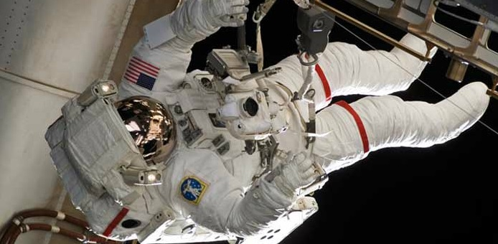
PARTS OF A SPACE SUIT

Slide 2
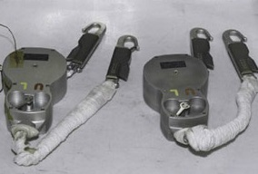
TETHERS
One end of these straps is attached to the spacewalker. The other end is connected to the vehicle. The safety tethers keep the astronauts from drifting away into space.

Slide 3
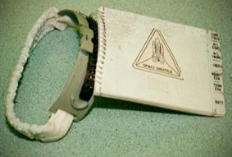
CUFF
One end of these straps is attached to the spacewalker. The other end is connected to the vehicle. The safety tethers keep the astronauts from drifting away into space.

Slide 4
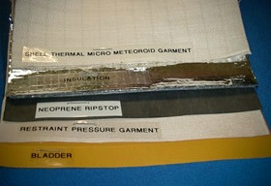
LAYERS
The spacesuit arm has 14 layers of material to protect the spacewalker. The liquid cooling and ventilation garment makes up the first three layers. On top of this garment is the bladder layer. It creates the proper pressure for the body. It also holds in the oxygen for breathing. The next layer holds the bladder layer to the correct shape around the astronaut's body and is made of the same material as camping tents. The ripstop liner is the tear-resistant layer. The next seven layers are Mylar insulation and make the suit act like a thermos. The layers keep the temperature from changing inside. They also protect the spacewalker from being harmed by small, high-speed objects flying through space. The outer layer is made of a blend of three fabrics. One fabric is waterproof. Another is the material used to make bullet-proof vests. The third fabric is fire-resistant.

Slide 5
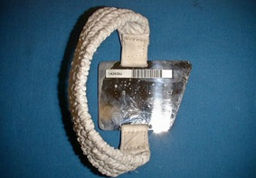
WRIST
A spacewalker cannot see the front of the Displays and Control Module while wearing the spacesuit. To see the controls, astronauts wear a wrist mirror on the sleeve. Look at the settings on the front of the module. They are written backward. But “backward” is “forward” in a mirror.

Slide 6
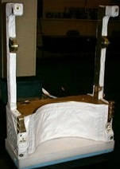
SAFER (SIMPLIFIED AID FOR EVA RESCUE)
SAFER is like a life jacket. Spacewalkers working on the space station wear SAFER. Astronauts are usually connected to the station by a tether. If an astronaut should become untethered and float away, SAFER would help her or him fly back to the station. SAFER is worn like a backpack. It uses small nitrogen-jet thrusters to let an astronaut move around in space. Astronauts can control SAFER with a small joystick.

Slide 7
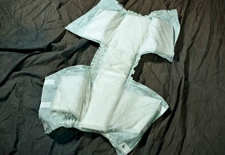
MAG (MAXIMUM ABSORPTION GARMENT)
Because spacewalks typically last more than six hours without a break, spacewalkers wear adult-sized diapers with extra absorption material under their spacesuits.

Slide 8
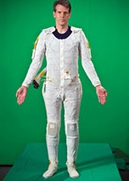
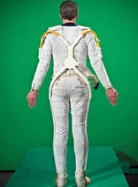
LCVG (LIQUID COOLING AND VENTILATION GARMENT)
Most long underwear keeps people warm. This underwear keeps spacewalkers cool. It is made of stretchy spandex material. It has 91.5 meters, or 300 feet, of narrow tubes throughout. Water is pumped through the tubes near the spacewalker's skin. The chilled water removes extra heat as it circulates around the crewmember’s entire body. The vents in the garment draw sweat away from the astronaut's body. Sweat is recycled in the water-cooling system. Oxygen is pulled in at the wrists and ankles to help with circulation within the spacesuit.

Slide 9
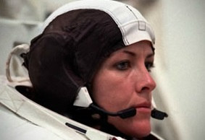
CCA (COMMUNICATIONS CARRIER ASSEMBLY)
The CCA is sometimes called the Snoopy Cap. The astronaut wears the cap under the helmet. It has earphones and microphones. It connects to the radio on the spacesuit. Using the CCA, astronauts can talk with the rest of the crew and hear the caution and warning tones.

Slide 10
HELMET

Slide 11
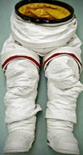
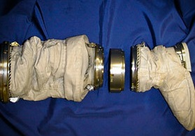
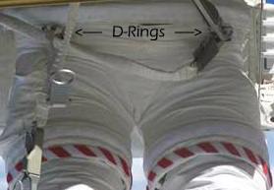
LOWER
This section is made up of spacesuit pants, boots and the lower half of the waist closure. A piece called the waist bearing helps the astronaut move and turn. A metal body-seal closure connects the lower torso to the hard upper torso.
The lower torso has D-rings to attach tethers. Tethers are the cords that attach to the spacecraft so spacewalkers will not float away.
Some suits are plain white; some have red stripes; and others have candy cane stripes. These variations help to tell one spacewalker from another.

Slide 12
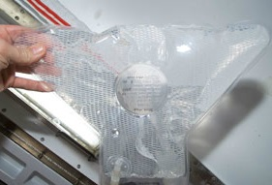
IDB (IN-SUIT DRINK BAG)
A plastic, water-filled pouch attaches to the inside of the Hard Upper Torso using Velcro. A plastic tube with a valve sticks out of the bag. The tube and valve can be adjusted to be near the astronaut's mouth. Biting the valve opens the tube so the spacewalker can take a drink. Releasing the bite closes the valve again.

Slide 13
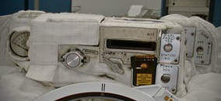
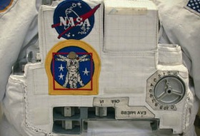
DCM (DISPLAYS AND CONTROL MODULE)
This module is the control panel for the mini-spacecraft. Switches, controls, gauges and an electronic display are on the module. The astronaut can operate the Primary Life Support Subsystem from this module.

Slide 14
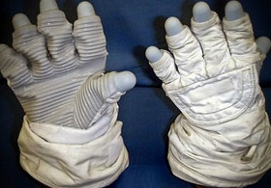
GLOVES
This module is the control panel for the mini-spacecraft. Switches, controls, gauges and an electronic display are on the module. The astronaut can operate the Primary Life Support Subsystem from this module.

Slide 15
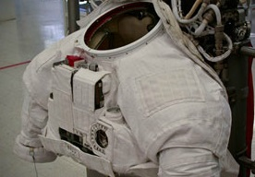
UPPER
The top of the spacesuit includes the Hard Upper Torso and the arm assembly.

Slide 16
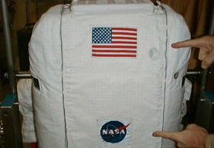
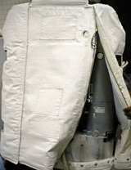
PLSS (PRIMARY LIFE SUPPORT SUBSYSTEM)
The PLSS is worn like a backpack. It provides astronauts many of the things they need to survive on a spacewalk. Its tanks supply oxygen for the astronauts to breathe. It removes exhaled carbon dioxide. It contains a battery for electrical power. The PLSS also holds water-cooling equipment, a fan to circulate oxygen and a two-way radio. A caution and warning system in this backpack lets spacewalkers know if something is wrong with the suit. The unit is covered with protective cloth layers.

Slide 17
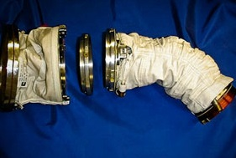
ARM
The PLSS is worn like a backpack. It provides astronauts many of the things they need to survive on a spacewalk. Its tanks supply oxygen for the astronauts to breathe. It removes exhaled carbon dioxide. It contains a battery for electrical power. The PLSS also holds water-cooling equipment, a fan to circulate oxygen and a two-way radio. A caution and warning system in this backpack lets spacewalkers know if something is wrong with the suit. The unit is covered with protective cloth layers.

Slide 18
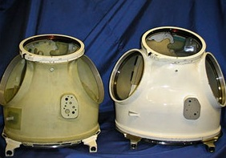
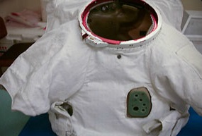
HUT (HARD UPPER TORSO)
The HUT covers the chest and back. It is a vest made out of fiberglass like some cars and swimming pools. The Displays and Control Module and Primary Life Support Subsystem attach to this piece. An important function of this piece is that it serves as the connection for the tubes that drain water and allow oxygen flow.

